Slide 1
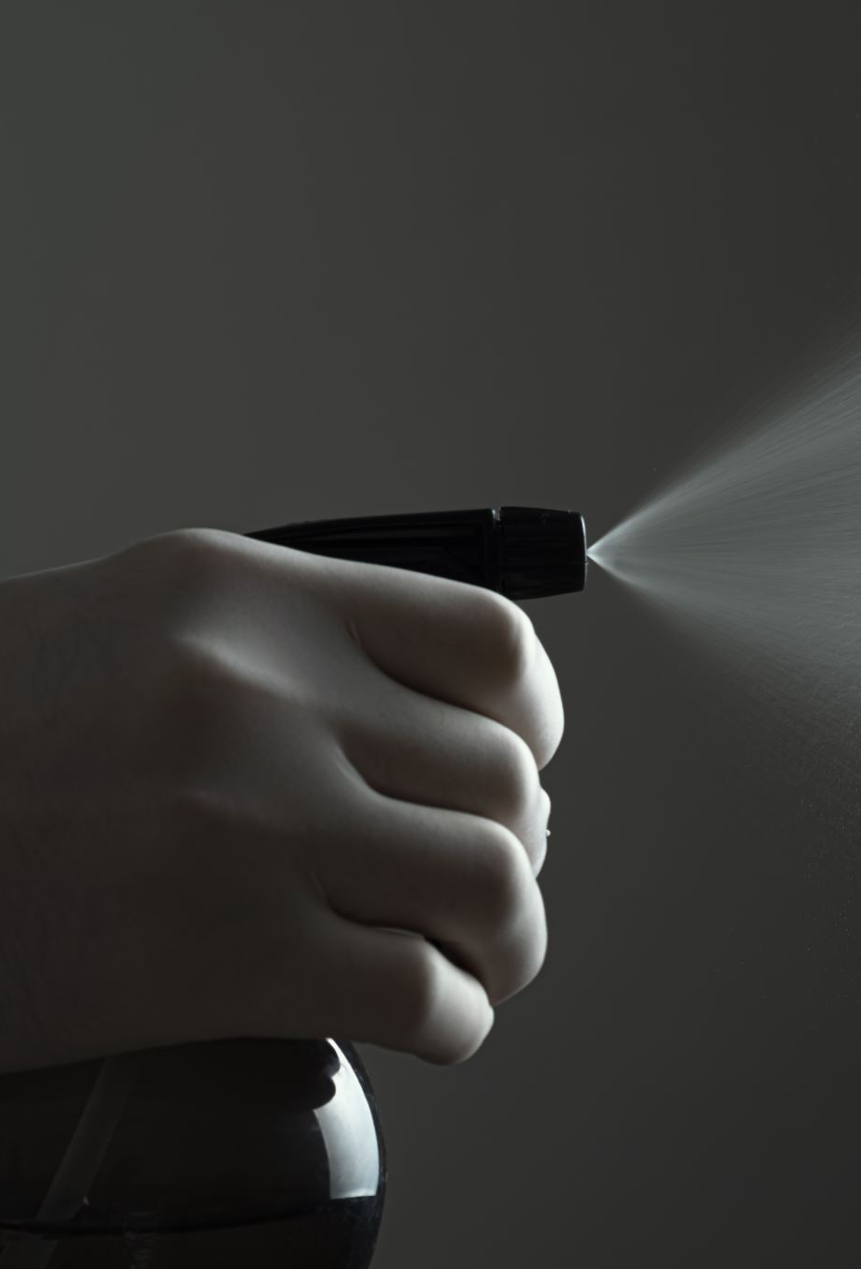
Smart Water Leak Detection for Bangalore
Leveraging IoT for Smart City Development
By
Bharath A Sayinath (21BCT0032)
Suraj Jha (21BCT0358) Darshan Bharat (21BCT0077)

Slide 2
Topic and Context
Title: IoT-based Water Leakage Management System for Bangalore
Context:
Long time to detect leakages in urban areas
Expensive damages to infrastructure.
Causes wider-spread of problems throughout residential/industrial complexes if left unsolved for long.
Growing water scarcity issues in urban areas
Importance of efficient water management
Role of IoT in modern infrastructure management
Project overview:
Integration of Arduino Board and Water Flow Sensor
Real-time monitoring and data transmission
Use of ThingSpeak as IoT server for remote access

Slide 3

Strengths and Weaknesses of Bangalore
Strengths:
Tech hub with skilled workforce
Existing skilled blue-collar workforce (plumbers etc.) with technical know-how
Growing awareness of environmental issues
Increased population participation in sustainable lifestyle management
Existing IT infrastructure to support IoT projects
Weaknesses:
Rapid urbanization leading to strain on water resources
Aging water supply infrastructure
Lack of thorough quality standard checks on new infrastructure
High water loss due to leakages and inefficient management
Infrastructural damage due to delayed response to water leakage

Slide 4
Aim and Objectives
Aim - To develop and implement an IoT-based water leakage detection and management system for Bangalore to reduce water wastage, related damages and improve supply efficiency.
Objectives:
Design and construct a water flow monitoring device using Arduino and Water Flow Sensor
Integrate the hardware with ThingSpeak IoT server for real-time data transmission
Allows Analysis of collected data to identify potential leakages and inefficiencies in the water supply system
Furthering Proposition of strategies for prompt intervention and maintenance based on the collected data

Slide 5
Scope and Limitations of the Work
Scope:
Development of prototype water flow monitoring device
Integration with ThingSpeak IoT platform
Recommendations for scaling the system city-wide
Limitations:
Initial implementation limited to a demo size area
Dependence on reliable internet connectivity for data transmission
Need for regular maintenance and calibration of sensors
Potential challenges in integrating with existing water supply infrastructure at scale
Privacy and security concerns related to data collection and transmission

Slide 6
Conceptual Framework / Research Design
System Components:
Hardware: Arduino Board, Water Flow Sensor
Software: Arduino IDE, ThingSpeak IoT platform
Network: Wi-Fi connectivity
Data Flow:
Water flow sensor collects real-time data
Arduino processes and transmits data
ThingSpeak receives and stores data
Officials access data through User Interface
Key Parameters:
Water flow rate (liters per minute)
Total water volume (liters)
Time-stamped data for trend analysis
Anomaly detection for potential leaks

Slide 7

Conceptual Framework / Research Design (Contd.)
Research Methodology:
Literature review on existing Leakage issue frequency and severity in Bangalore, impact on water stress, water scenario in Bangalore, flaws in existing management system.
Analysis of Bangalore's water supply network
Prototype development and testing
Data analysis and interpretation

Slide 8

Proposed Idea
System Architecture:
Diagram showing interconnection of components
Water supply pipe → Flow sensor → Arduino → Wi-Fi → ThingSpeak → User interface
Hardware Setup:
Arduino Board: Central processing unit
Water Flow Sensor: YF-S201 or similar
Wi-Fi Module: ESP8266 for internet connectivity
Software Integration:
Arduino IDE: Programming the microcontroller
ThingSpeak API: Data transmission and storage

Slide 9

Proposed Idea (Contd.)
Expected Outcomes:
Real-time monitoring of water flow
Early detection of leaks and anomalies
Data-driven decision making for maintenance
Reduction in water wastage and associated costs
Innovative Aspects:
Low-cost, scalable solution
Integration with existing infrastructure
Real-time alerts and remote monitoring
Potential for predictive maintenance using collected data
Future Enhancements:
Integration with smart water meters
AI-powered predictive analytics
Mobile app for public engagement and reporting

Slide 10
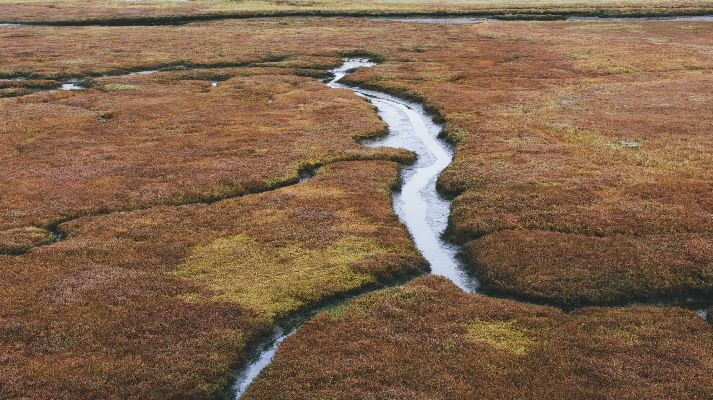
Literature Survey
Bangalore Losing 1 Million Liters of Water Per Day Due to Cauvery Pipeline Leakage (India Today, 2021)​ (India Today)
A six-month leakage from the Cauvery pipeline caused a loss of 1 million liters of water per day in Bangalore, highlighting inefficiencies in timely maintenance and management of vital infrastructure.
The COVID-19 pandemic and lack of labor contributed to the delay in repairs, showing systemic vulnerabilities.
Water Losses Management in Urban Water Distribution Systems (SpringerLink, 2020)​ (SpringerLink)
Focuses on the urban water distribution system's flaws, emphasizing the pressure-leakage response of water pipelines and its impact on water loss.
Highlights statistical modeling to estimate water leakage and underscores the need for technology integration in urban water systems.

Slide 11

Literature Survey (Contd.)
3. Bengaluru Water Crisis: A Case of Inadequate Water Management (Vivekananda International Foundation, 2023)​ (Vivekananda International Foundation)
Discusses the water stress crisis in Bangalore due to unplanned urbanization, groundwater depletion, and neglect of water bodies.
Water shortages and supply mismanagement led to emergency measures like water rationing and fines for non-essential use, with limited long-term strategies in place.
4. Water Crisis Management in Bangalore (VIF, 2022)
Investigates the root causes of the water stress situation in Bangalore, including rainfall deficits and over-reliance on aging infrastructure.
Suggests that the government must enhance communication strategies and focus on long-term water conservation projects, such as rainwater harvesting and lake rejuvenation.

Slide 12

Literature Survey (Contd.)
5. An Integrated Approach to Water Leakage Management in Indian Cities (Water Resources Management Journal, 2022)
Evaluates the existing leakage management practices in Bangalore, pointing out inefficient data collection and poor maintenance as major issues leading to persistent leakages.
Recommends the adoption of IoT-based real-time monitoring systems to improve the detection of leaks.
6. Water Scarcity and Governance in Bangalore (Water Research Institute, 2021)
Analyzes the governance issues contributing to water scarcity, citing improper allocation of resources, insufficient maintenance of water infrastructure, and lack of community involvement in managing resources.
Emphasizes the need for decentralized water management systems and better urban planning policies.
7. Experimental Investigation of Leak Hydraulics in Urban Water Systems (Journal of Hydroinformatics, 2020)​ (SpringerLink)
Studies the hydraulic behavior of leaks in Bangalore's water pipes and the challenges in accurately detecting and fixing these leaks.
Promotes the use of advanced sensor networks and data-driven models to enhance the city's water leakage detection capabilities.

Slide 13
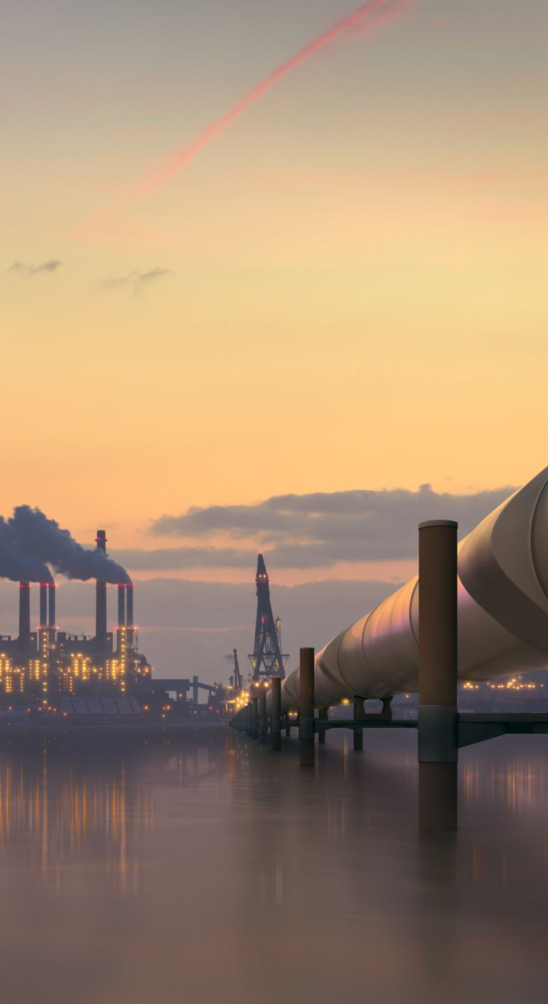
Key Features of the Project
Challenges in the Project
Diverse Water Infrastructure in Bangalore
Adapting to varying pipe conditions across old and new areas of the city
Integrating with both centralized and decentralized water supply systems
Bangalore's Rapid Urban Expansion
Keeping pace with the city's fast-growing suburbs and tech parks
Addressing unauthorized connections in informal settlements
Power Fluctuations
Designing system to handle Bangalore's occasional power outages
Exploring solar power options for sensors in areas with unreliable electricity
Data Management at City Scale
Handling large volumes of data from Bangalore's population of over 12 million
Ensuring data accuracy across the city's diverse topography

Slide 14

Key Features of the Project (Contd.)
Stakeholder Coordination
Aligning project goals with various departments of BWSSB
Coordinating with Bangalore Metropolitan Region Development Authority (BMRDA)
Public Perception and Privacy Concerns
Addressing potential concerns about water usage monitoring in residential areas
Ensuring data privacy in a tech-savvy city like Bangalore
Regulatory Compliance
Adhering to Karnataka State Water Policy
Complying with both national and state-level IoT and data protection regulations
Seasonal Variations in Water Supply
Adapting the system to handle fluctuations during Bangalore's dry seasons
Accounting for increased water demand during summer months

Slide 15
Features and Benefits to Bangalore
Addressing Bangalore's Water Scarcity
Potential to save millions of liters of water annually through leak detection
Supporting BWSSB's efforts to reduce non-revenue water loss
Cost Savings for BWSSB
Reducing operational costs associated with water loss
Optimizing maintenance schedules based on real-time data
Improved Water Distribution in Bangalore
Equitable water distribution across different zones of the city
Potential to alleviate water shortages in chronically affected areas
Support for Bangalore's Sustainable Development
Contributing to Bangalore's goal of becoming a water-positive city
Aligning with Karnataka's water conservation initiatives

Slide 16
Features and Benefits to Bangalore (Contd.)
Enhanced Disaster Preparedness
Quick identification of major leaks or pipeline bursts
Improved response time during water-related emergencies
Data-Driven Urban Planning
Providing valuable insights for Bangalore's future infrastructure projects
Supporting decisions on water harvesting and conservation initiatives
Public Health Benefits
Reducing risks of water contamination due to pipeline leaks
Ensuring consistent water supply crucial for sanitation in densely populated areas

Slide 17
Features and Benefits to Bangalore (Contd.)
Boost to Bangalore's Tech Ecosystem
Showcasing Bangalore as a leader in smart water management
Potential for local tech companies to participate in system development and maintenance
Environmental Impact
Reducing energy consumption in water pumping and treatment
Contributing to the preservation of Bangalore's lakes and groundwater
Citizen Engagement and Awareness
Increasing public awareness about water conservation
Empowering Bangalore residents with information about their water supply

Slide 18
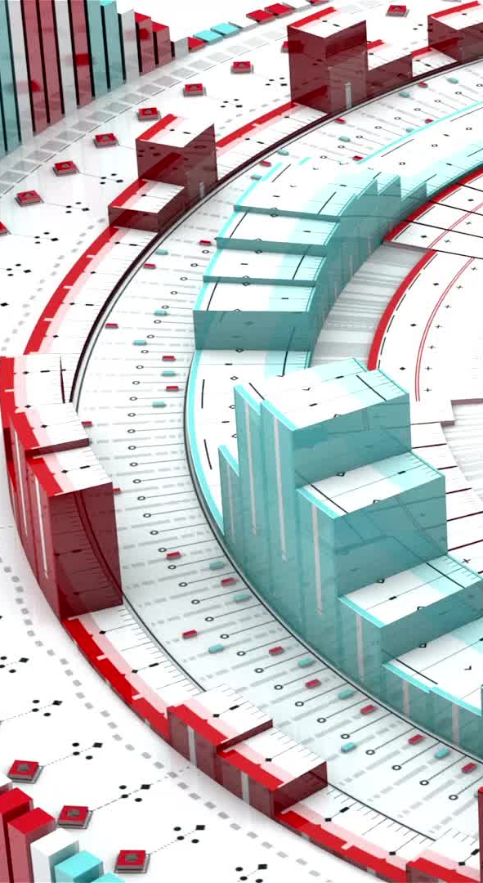
Data Collection and Organization
The data collected presents a comprehensive overview of Bangalore's water supply situation from 2000 to 2025, including historical data and future projections. It covers various aspects such as population growth, water availability, demand, supply, unaccounted for water (UFW), and infrastructure capacity.
Key Findings:
1. Population Growth: Bangalore's population is projected to grow from 5.7 million in 2000 to 9.7 million by 2025, putting increasing pressure on water resources.
2. Water Demand-Supply Gap: The gap between water demand and supply is widening. In 2007, the shortage was 541 MLD, projected to reach 514 MLD by 2025 despite planned supply increases.
3. Unaccounted for Water (UFW): UFW has increased significantly from 33% in 2000 to 48% in 2007, representing a major inefficiency in the system.
4. Per Capita Availability: Current per capita water availability is only 74-75 LPCD, far below the standard of 150 LPCD recommended by CPEEHO.

Slide 19

Data Collection and Organization (Contd.)
5. Infrastructure Capacity: Total installed capacity from all sources is 959 MLD, but actual availability is 923 MLD, indicating some sources are underperforming.
6. Cost Recovery: The average cost of water supply (Rs 13.20 per cubic meter) significantly exceeds the average revenue (Rs 8.67 per cubic meter), indicating poor cost recovery.
7. Water Leakages: Main pipes (38.1%) and service pipes (32.8%) account for the majority of water leakages.
8. Groundwater Depletion: Annual groundwater extraction (207,000 ML/yr) far exceeds the annual recharge (81,100 ML/yr) in the Bangalore Metropolitan Region.
9. Wastewater Treatment: Only 721 MLD out of 1000 MLD of generated wastewater is treated, with only 70 MLD undergoing tertiary treatment for reuse.
10. Financial Impact: The annual revenue loss due to UFW is estimated at Rs 27 crores.
These findings highlight significant challenges in Bangalore's water management, including rapid urbanization, infrastructure inefficiencies, unsustainable groundwater use, and financial constraints. The data suggests an urgent need for comprehensive water management strategies to address these issues.

Slide 20
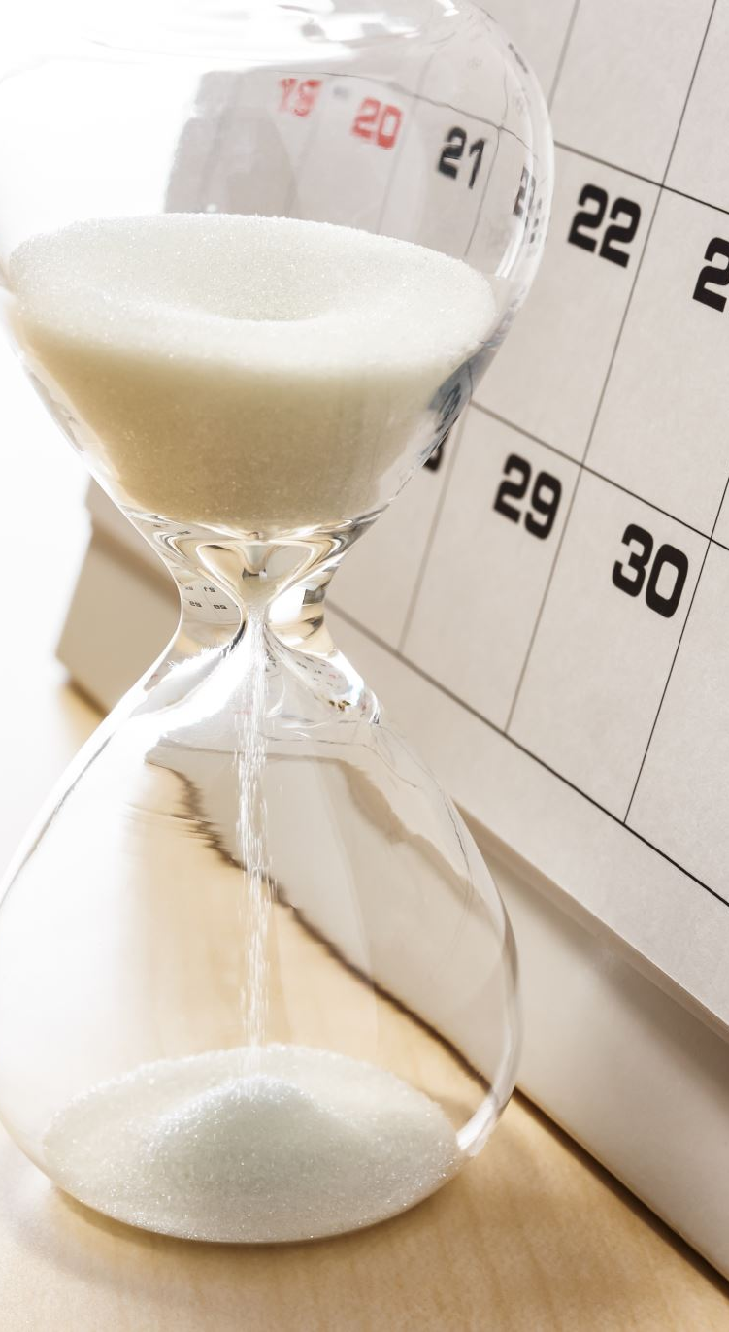
Data Collection Sources
Saleth, Rathinasamy & Sastry, G.S.. (2004). Water Supply and Sanitation Sector of Karnataka, India: Status, Performance and Change. Water Policy. 6. 161–183. 10.2166/wp.2004.0011.
Biswas, Asit & Tortajada, Cecilia & Izquierdo-Avino, Rafael. (2009). Water Management in 2020 and Beyond. Water Management in 2020 and Beyond edited by Asit K. Biswas, Cecilia Tortajada, and Rafael Izquierdo-Avino. Berlin: Springer, 2009. ISBN: 978-3-540-89345-5.
Raj, Krishna. (2013). Sustainable Urban Habitats and Urban Water Supply: Accounting for Unaccounted for Water in Bangalore City, India. Current Urban Studies. 01. 156-165. 10.4236/cus.2013.14017.
BWSSB Annual Report (2022)
BWSSB Initiatives (2023)
Karnataka Water Resource Management Report (2022)

